Slide 1
Jive

Slide 2
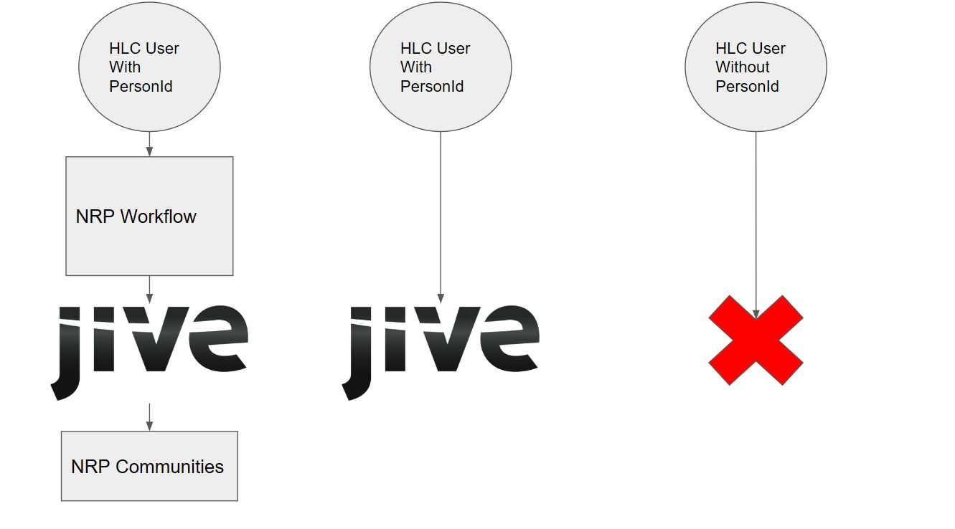

Slide 3
Jive API calls –
These are used to create a user account and grant/remove access to JIVE. They are triggered based on the user satisfying NRP workflow needs and becoming eligible to get access to Jive and enrolling in an eligible NRP course.
SSO –
Single Sign On. Users who have an HLC account and a linked Jive account using their HealthStream ID can login into the HLC and SSO over to Jive using an SSO redirect URL. STS stores login information and passes it over to Jive.
SLO –
Single Log Off. Users who have an HLC account and a linked Jive account using their HealthStream ID can login into the HLC and SSO over to Jive using an SSO redirect URL. When they log off of the HLC, they get logged off Jive, as STS is the source of truth. It’s a one way SSO, so if the user logs off of Jive, it will not log the user out of the HLC.

Slide 4
NRP Workflow

Slide 5
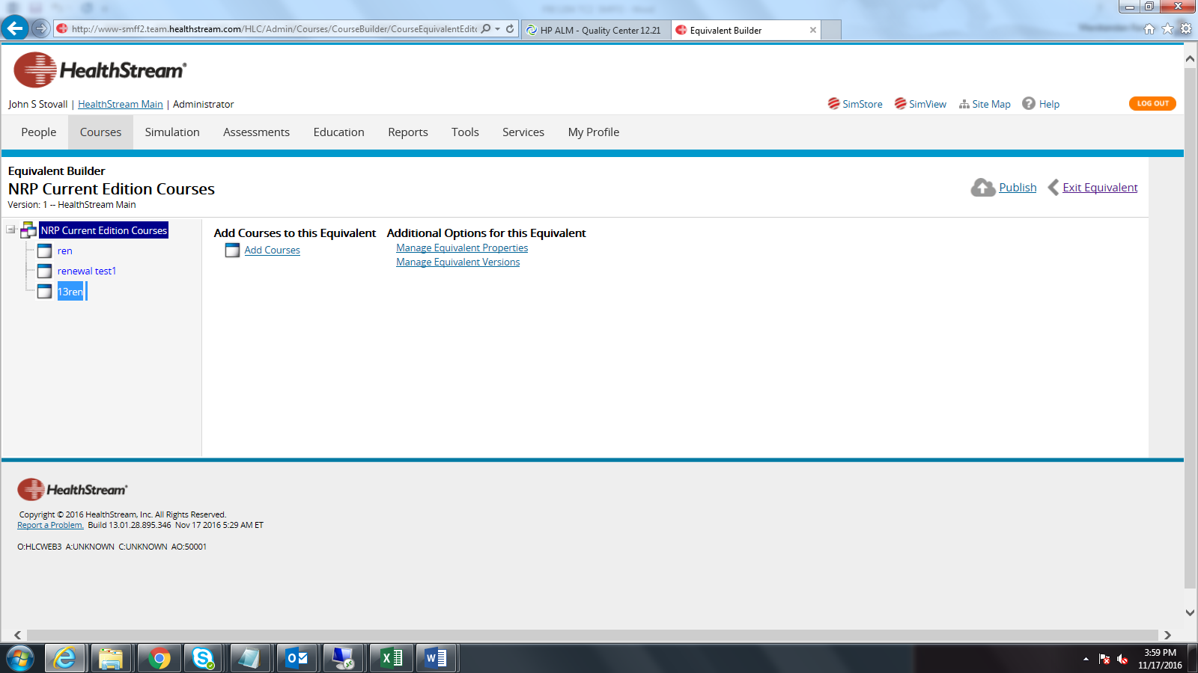

Slide 6
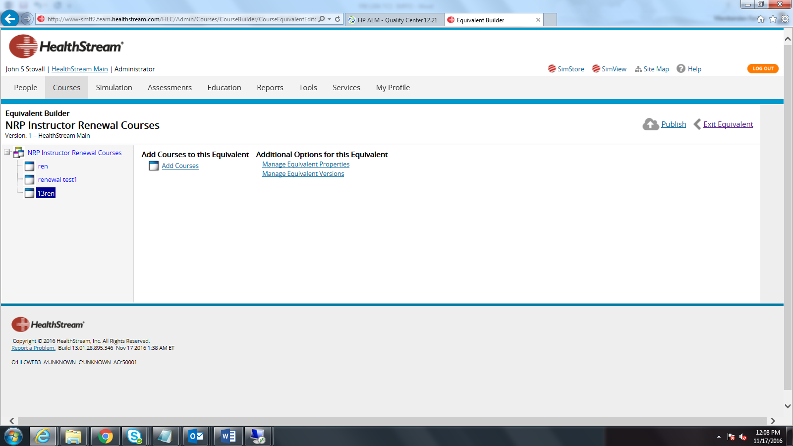

Slide 7
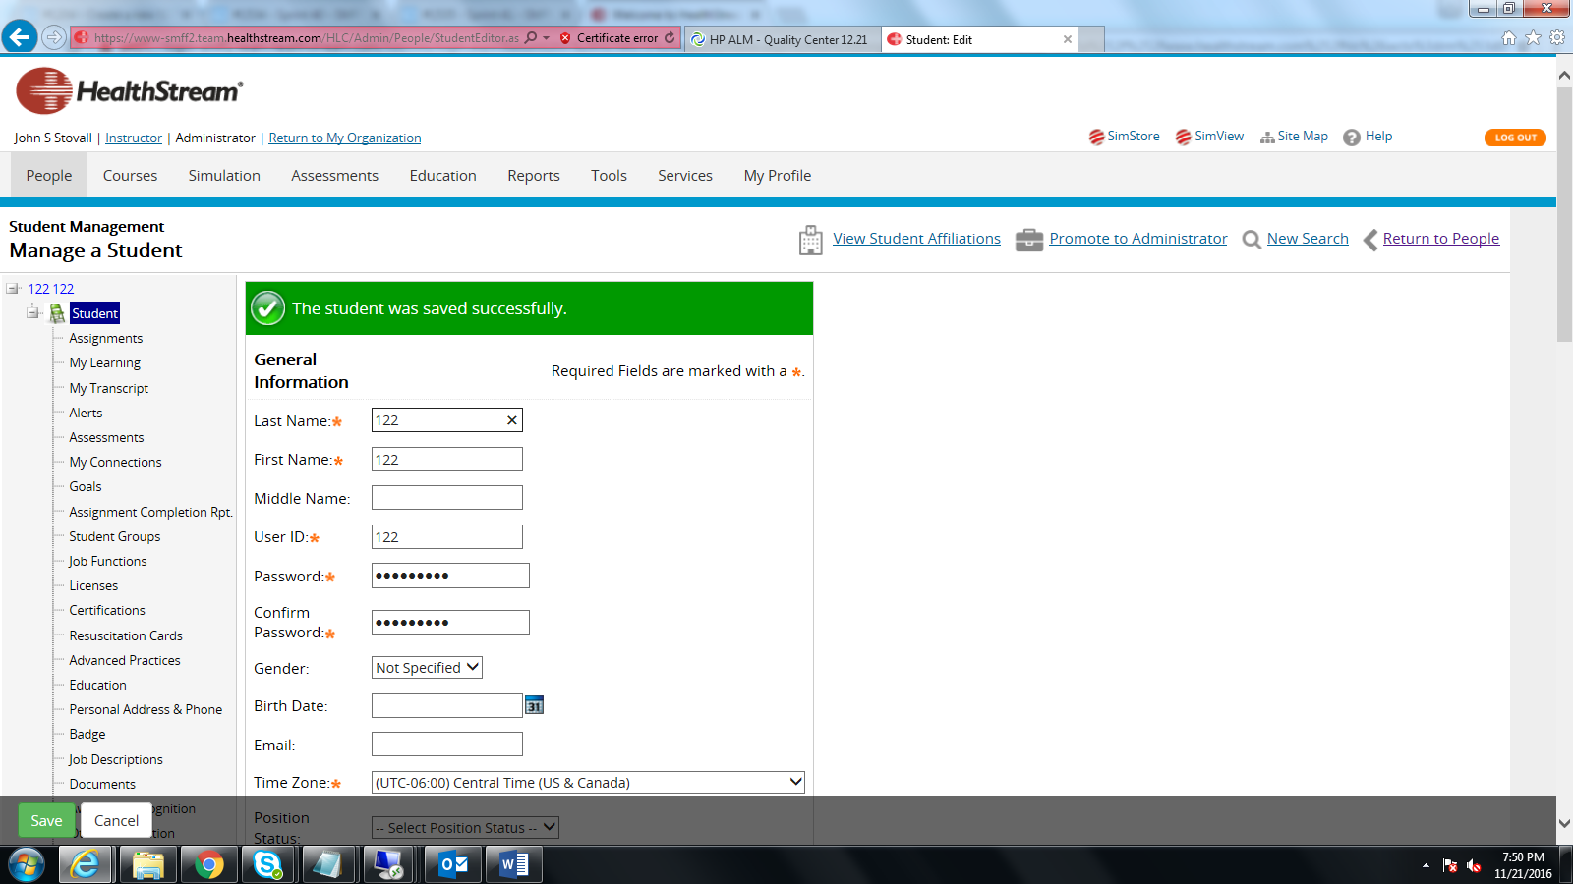

Slide 8
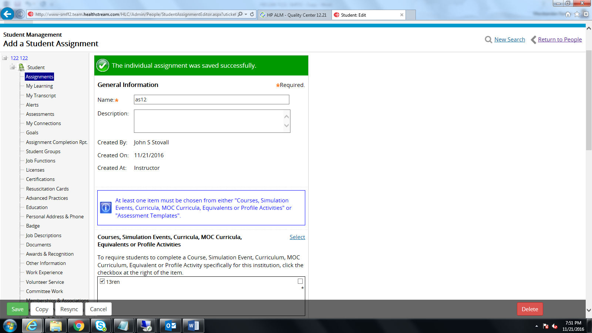

Slide 9
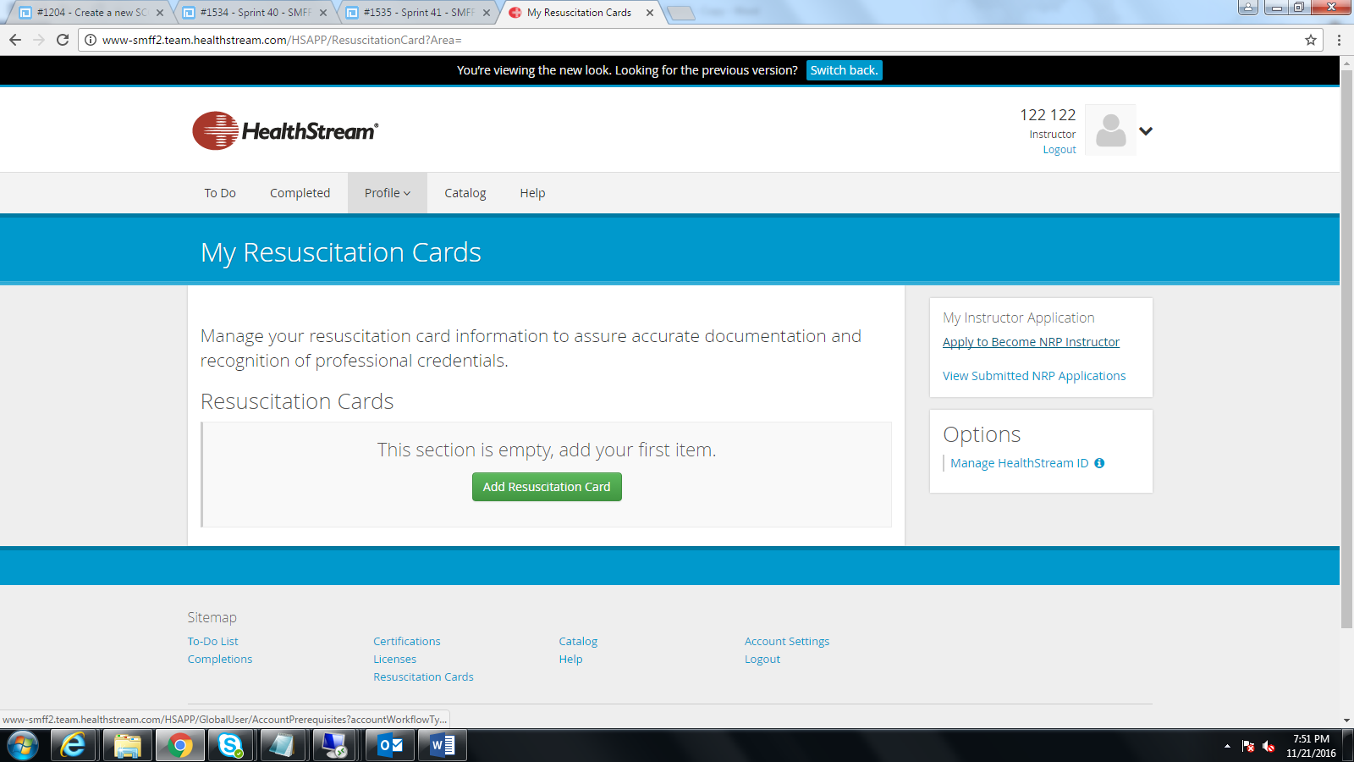

Slide 10
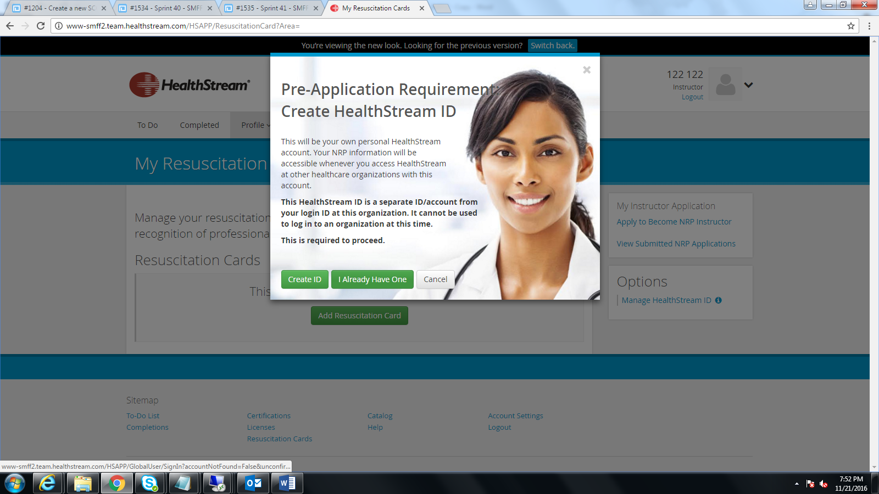

Slide 11
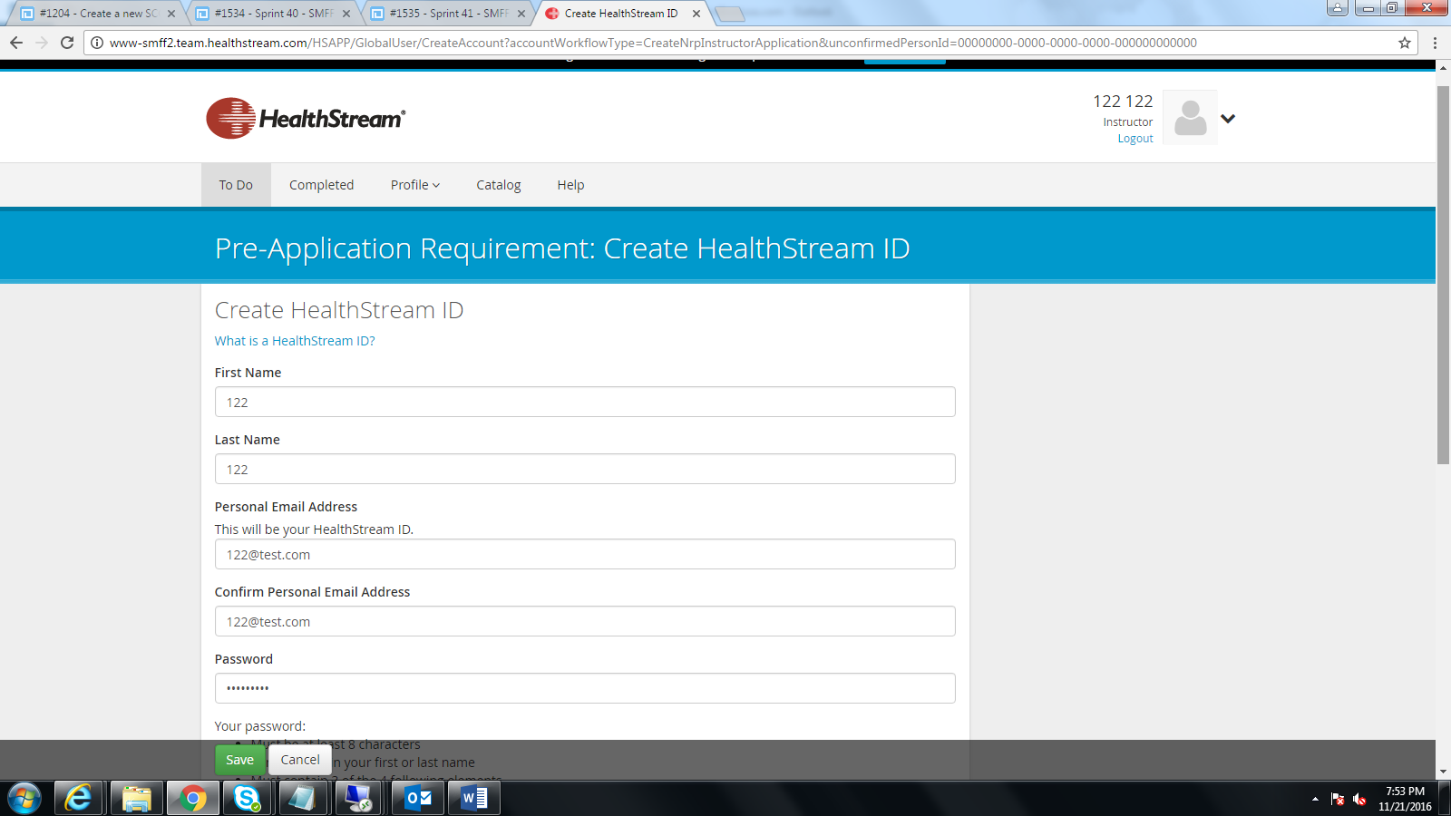

Slide 12
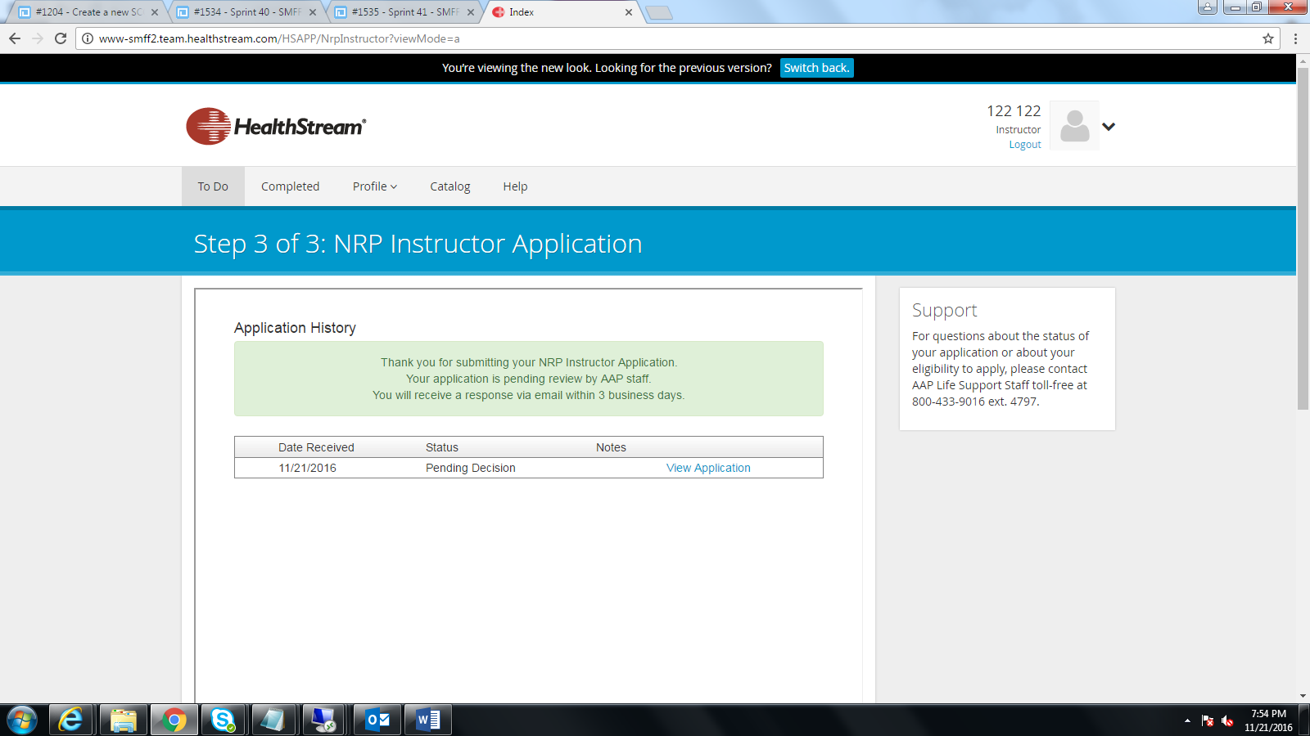

Slide 13
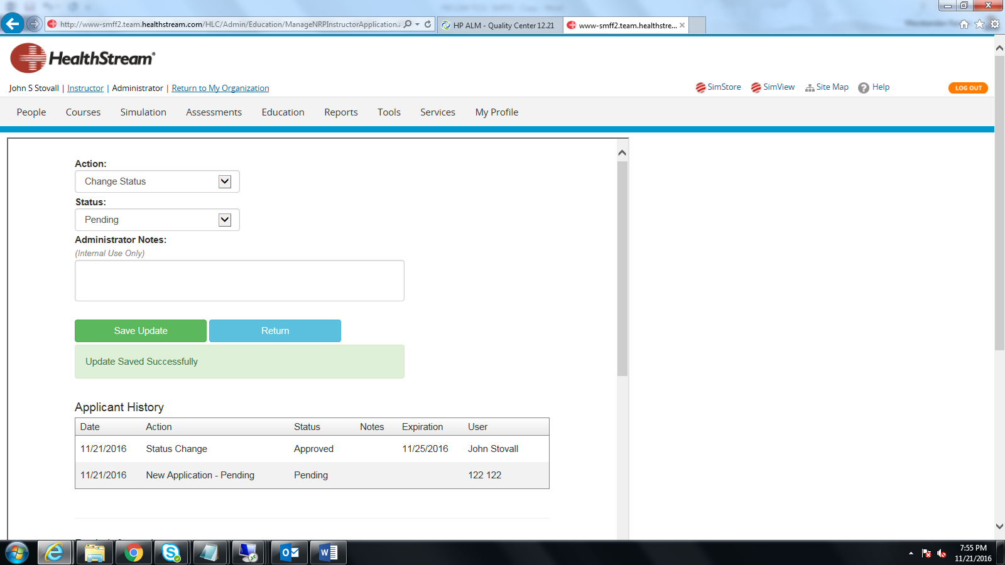

Slide 14
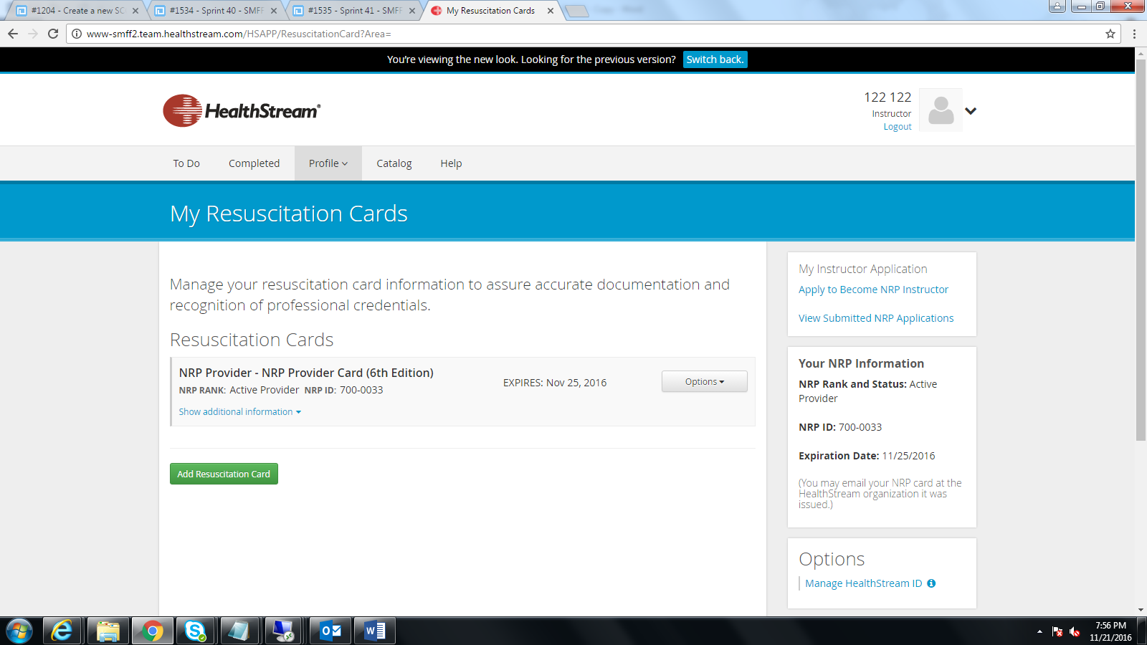

Slide 15
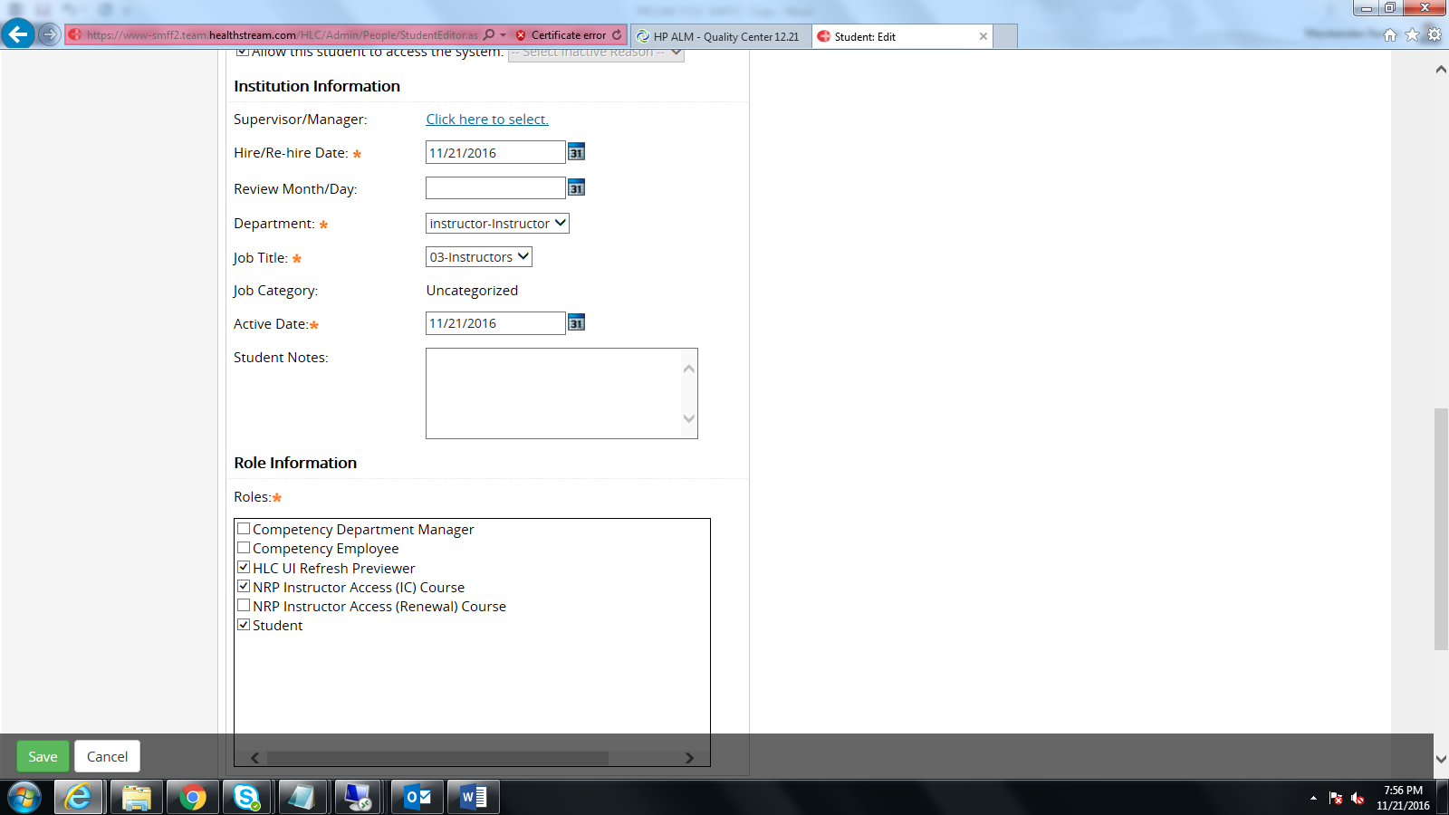

Slide 16
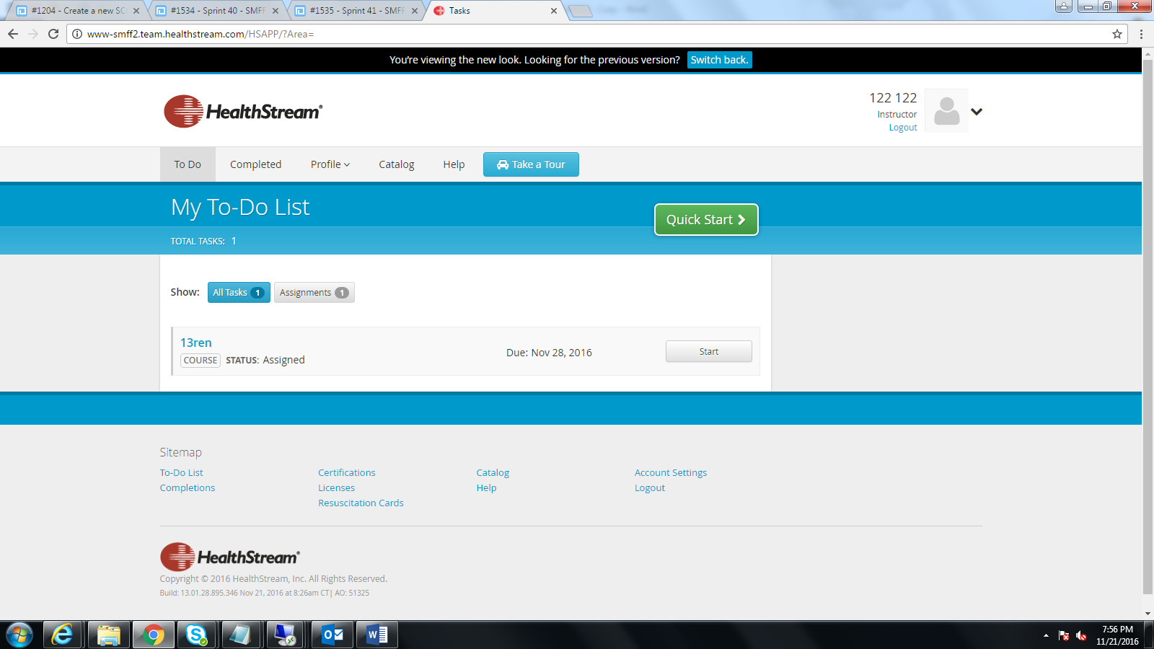

Slide 17
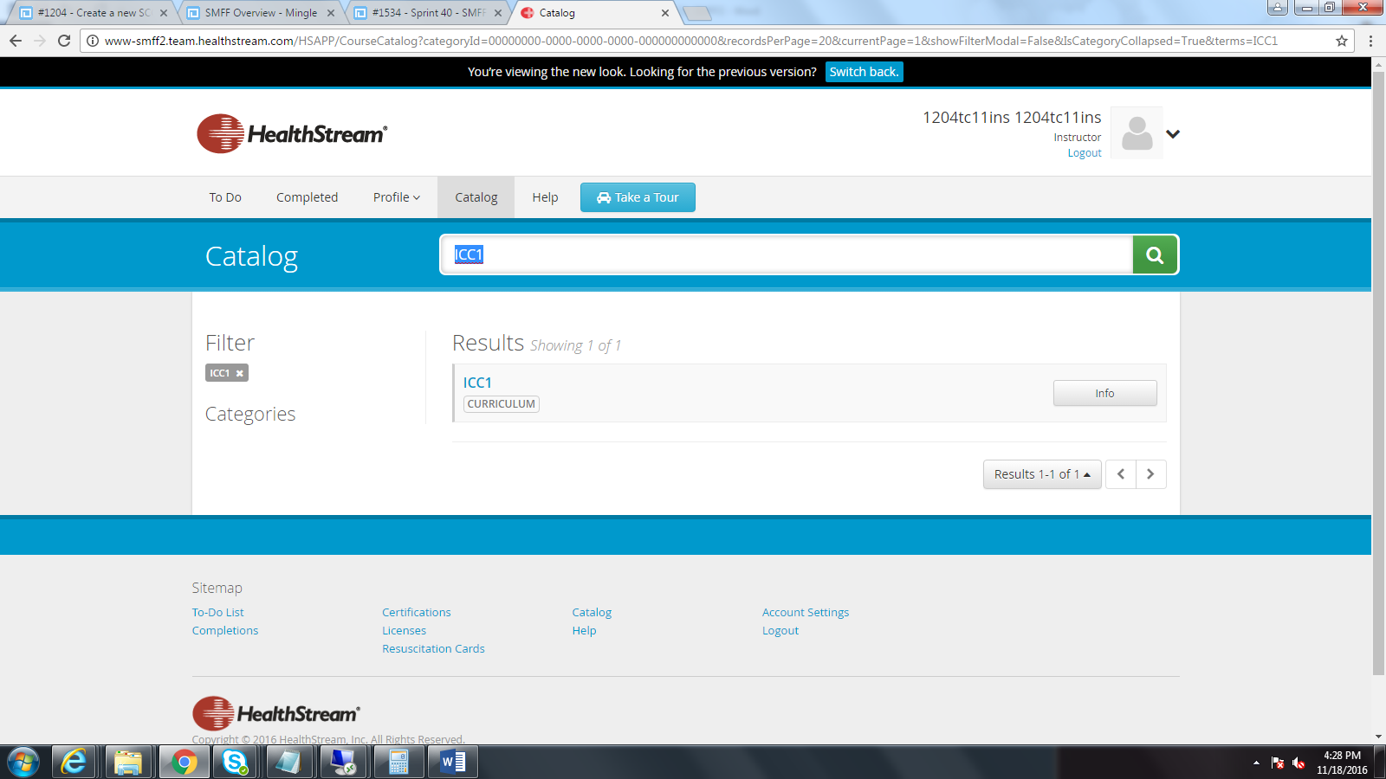

Slide 18
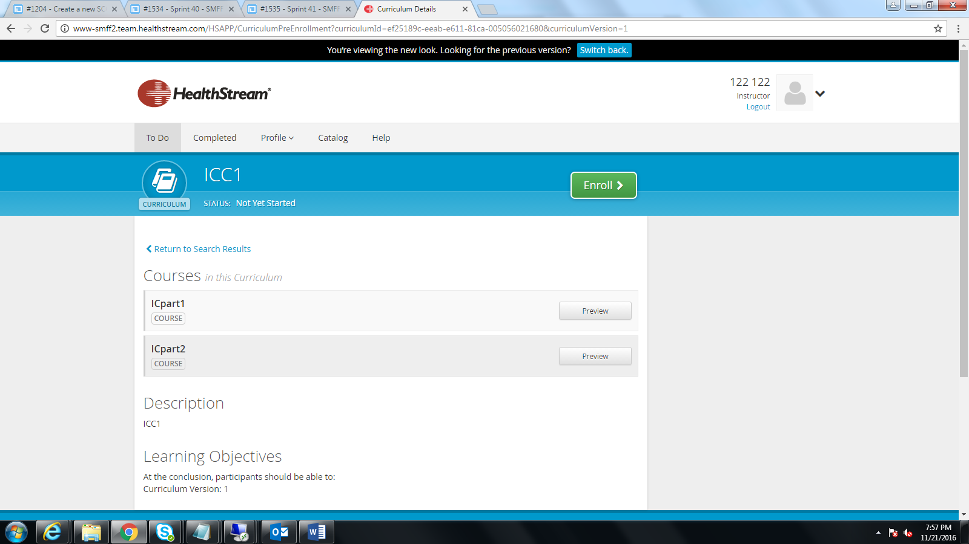

Slide 19
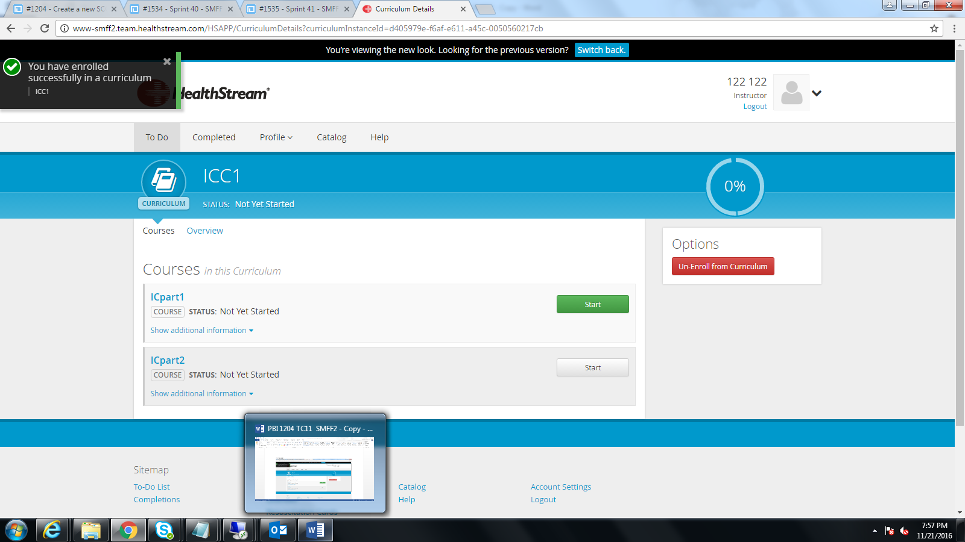

Slide 20
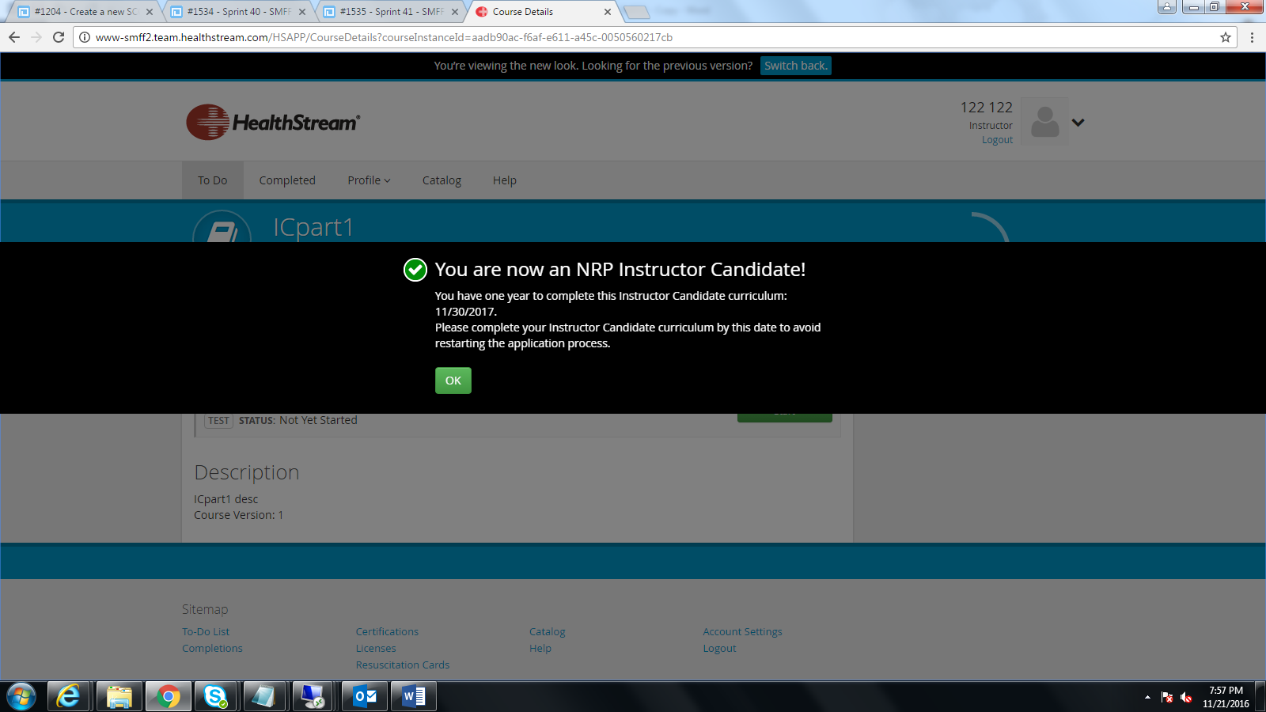

Slide 21
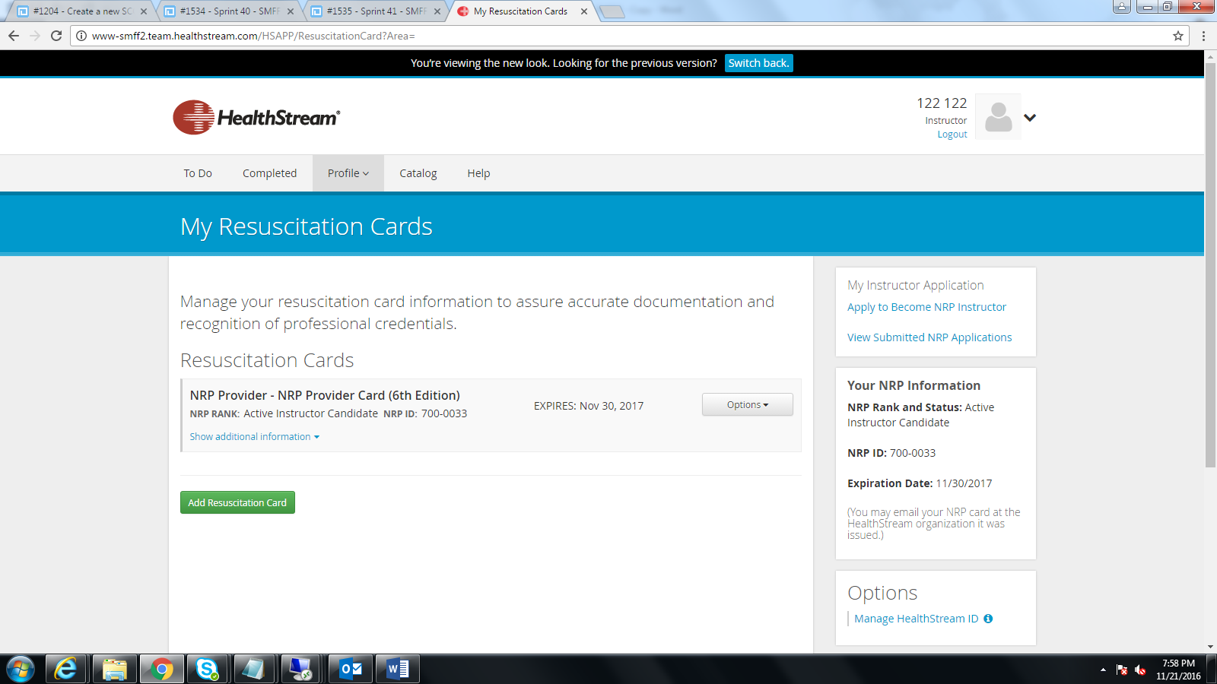

Slide 22
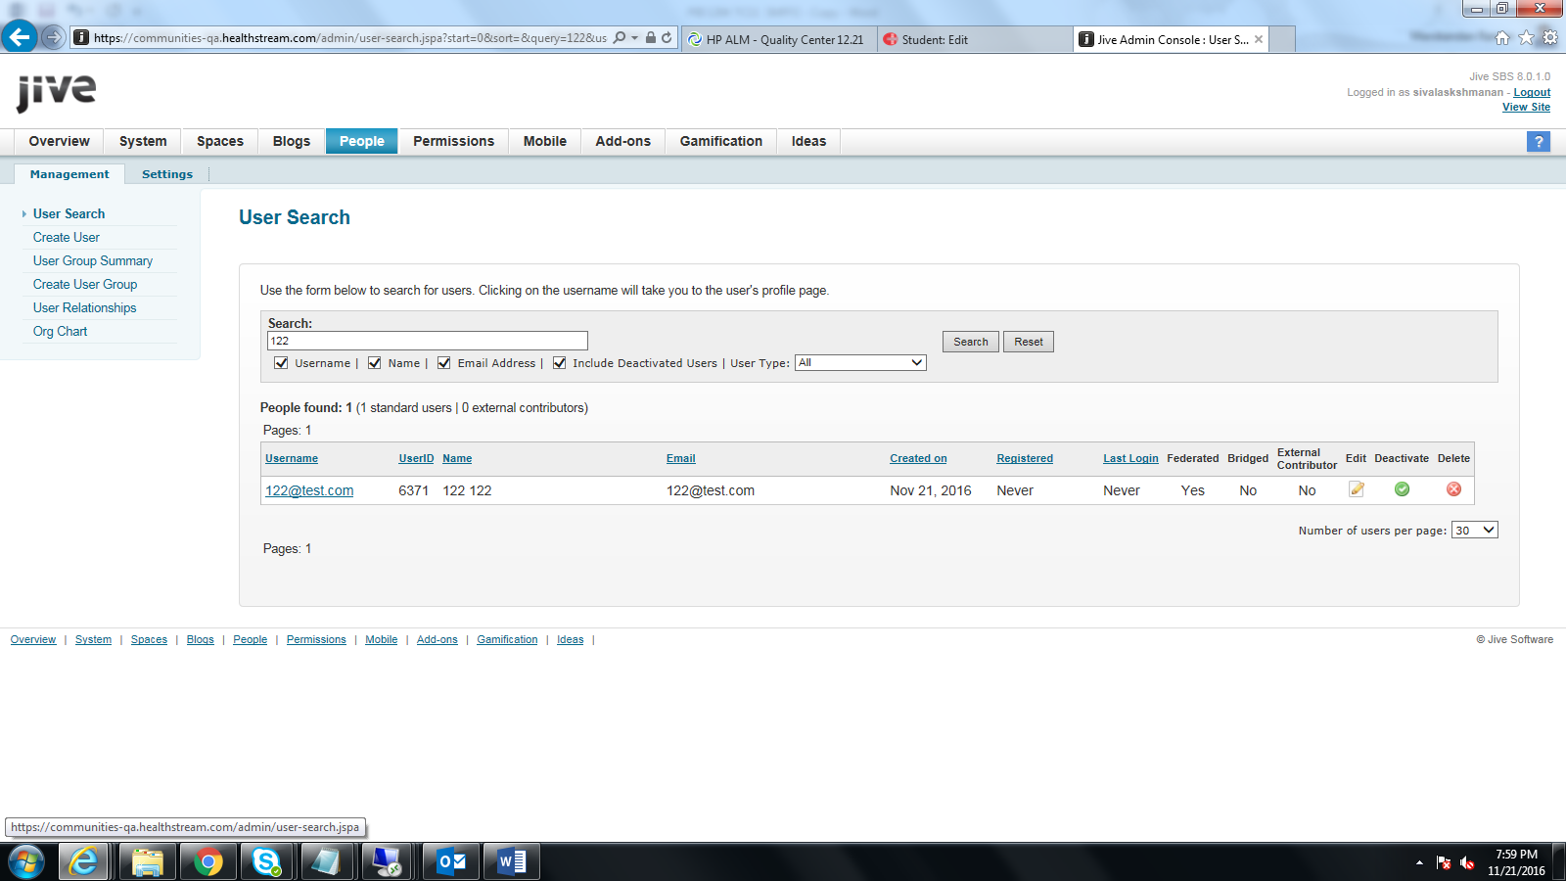

Slide 23
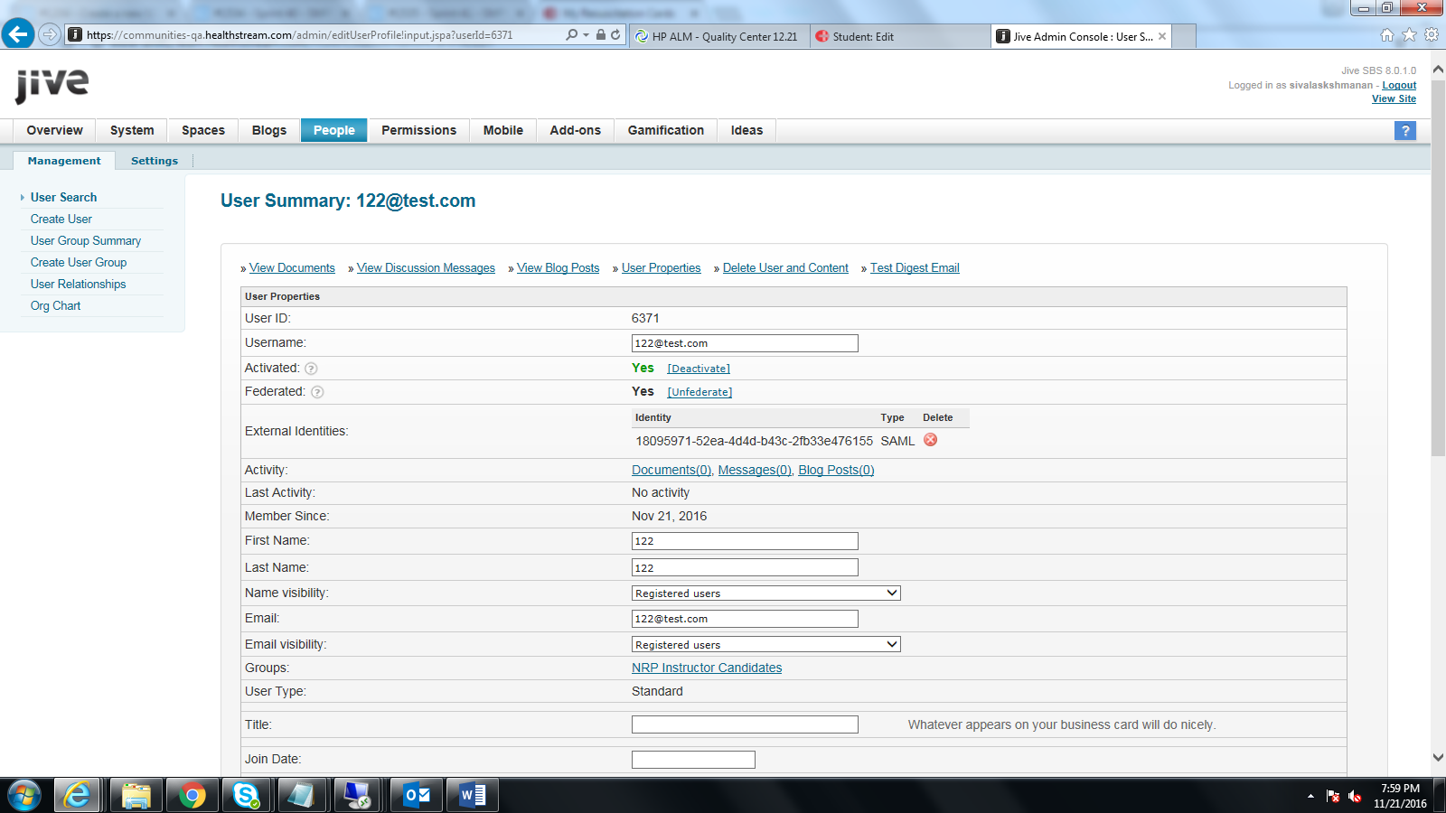

Slide 24
SSO

Slide 25
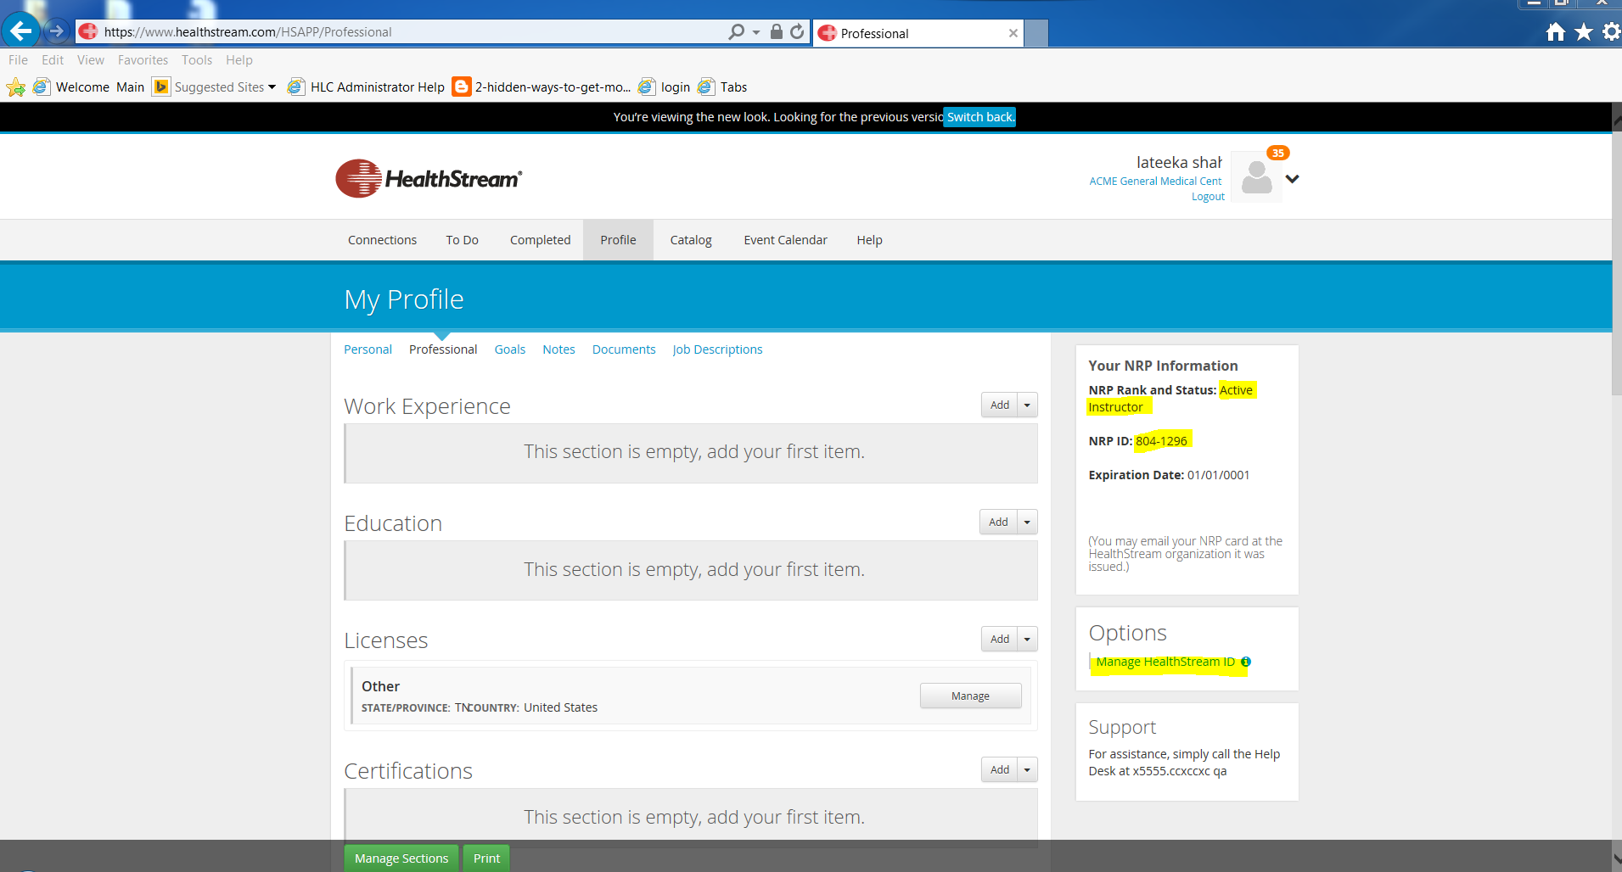

Slide 26
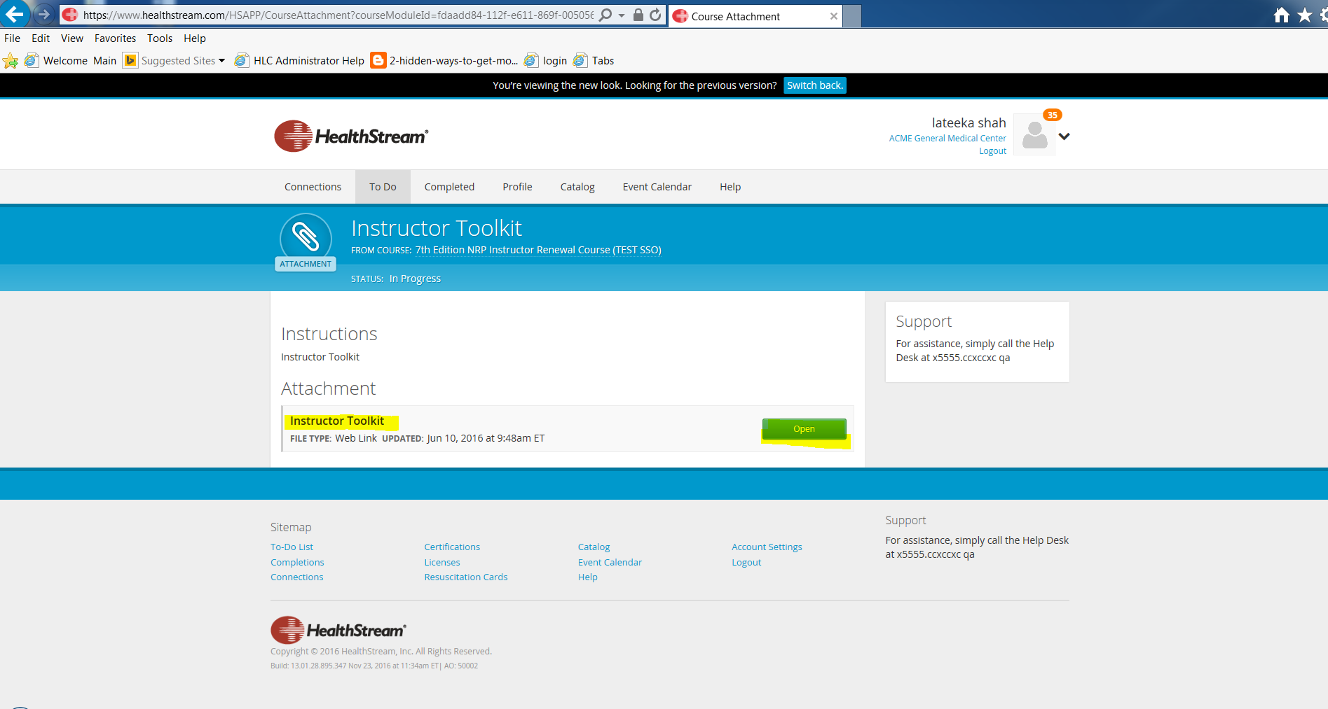

Slide 27
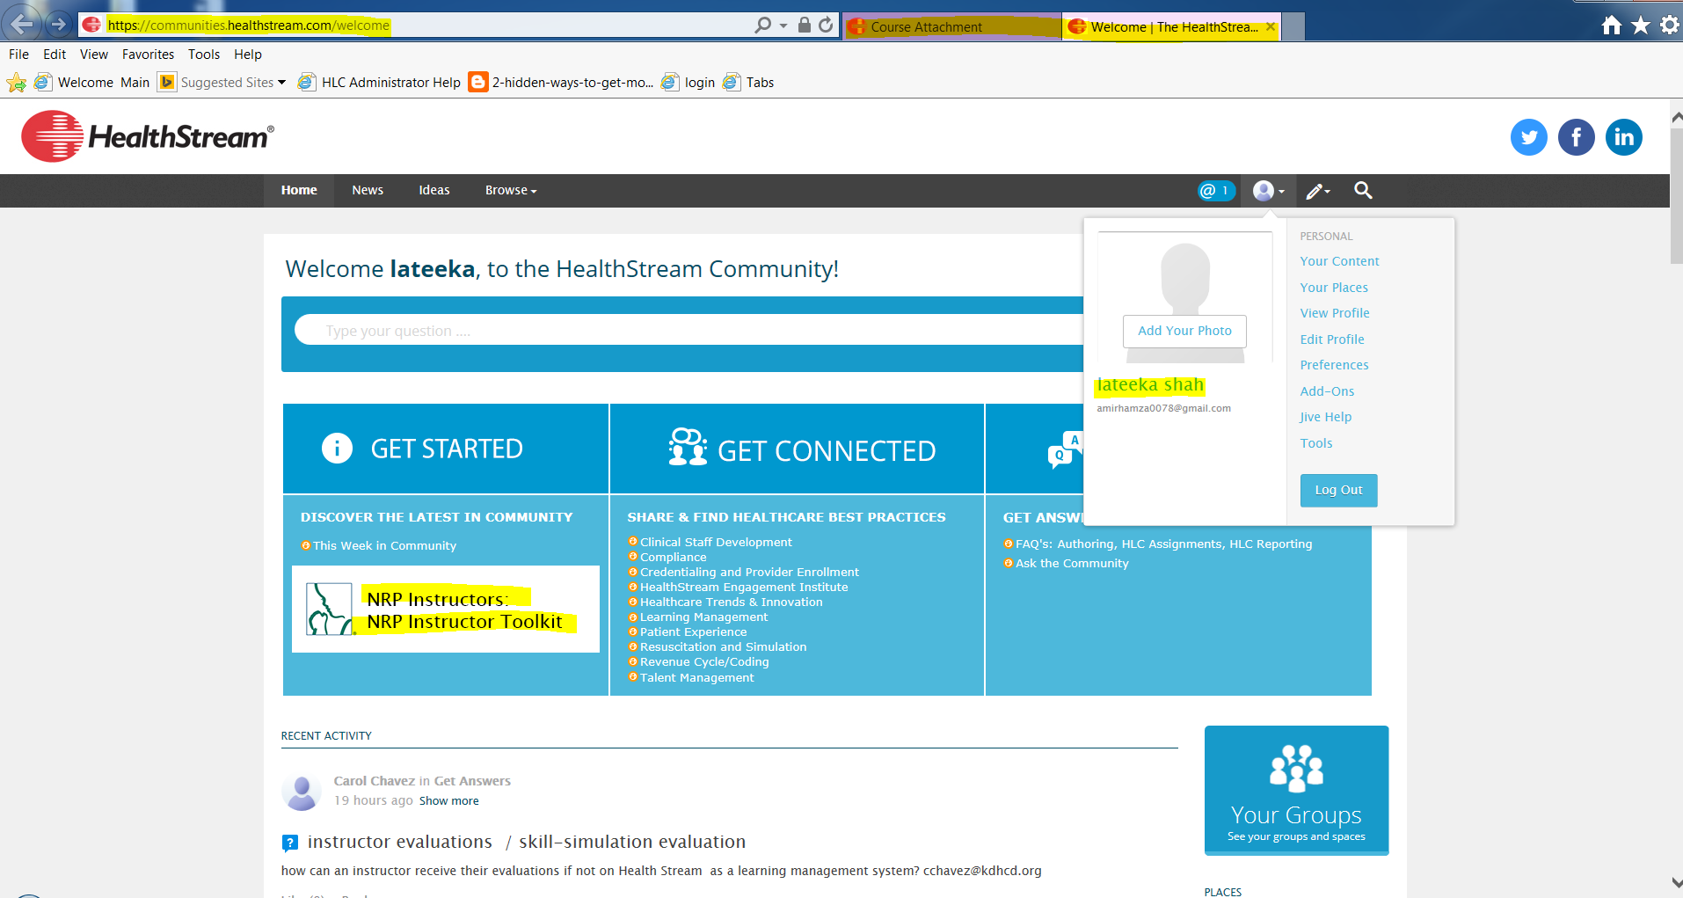

Slide 28
